Slide 1

🎓 AI/ML INTERNSHIP
COMPLETION
UNIFIED MENTOR
Nov 2025 - Feb 2026
4 Projects • 85-92% Accuracy • Swipe to see results →

Slide 2
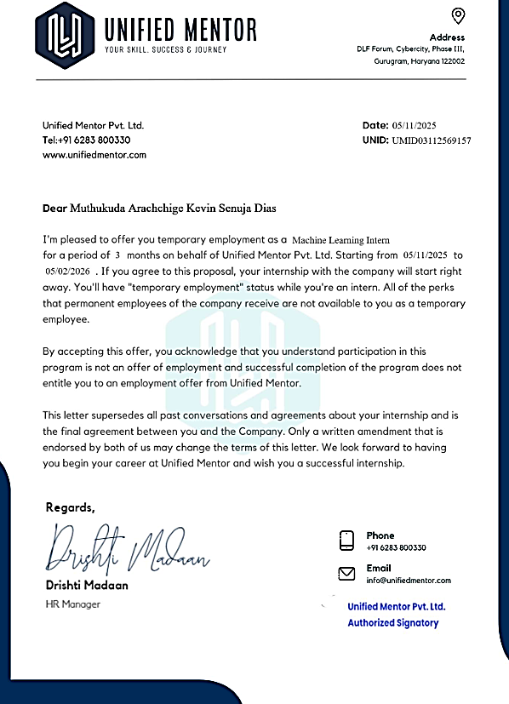
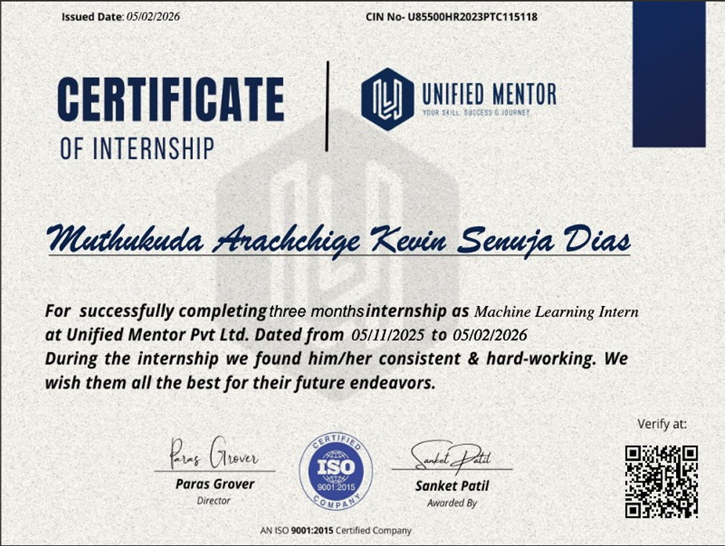
📜 Offer Letter & Letter of Recommendation

Slide 3
🚀 4 PROJECTS DELIVERED
📱 Mobile Price Classifier 88% Accuracy • Random Forest
🐾 Animal Image Classifier 72% Accuracy • CNN + VGG16
💓 Heart Disease Detection 85% Accuracy • Classification
🚗 Vehicle Price Predictor
• Linear Regression

Slide 4

📊 Mobile Price Classifier

Slide 5
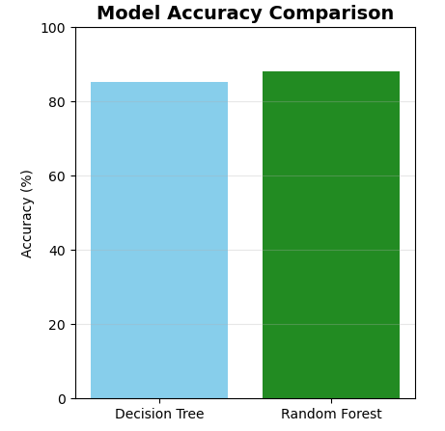
🔄 Mobile Price - Model Comparison

Slide 6
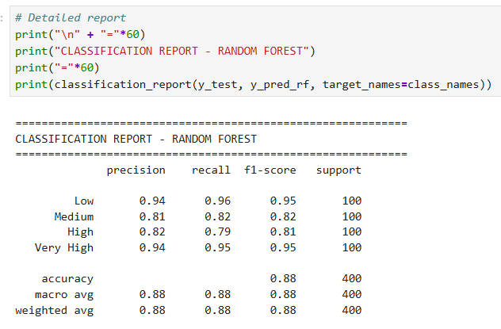
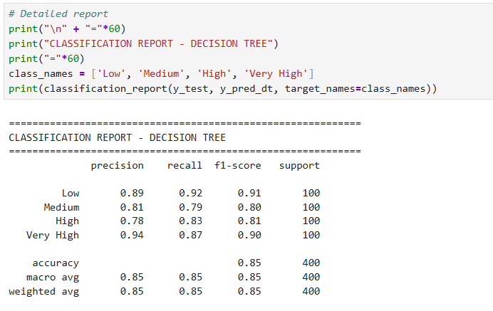
🔄 Mobile Price - Model Comparison

Slide 7
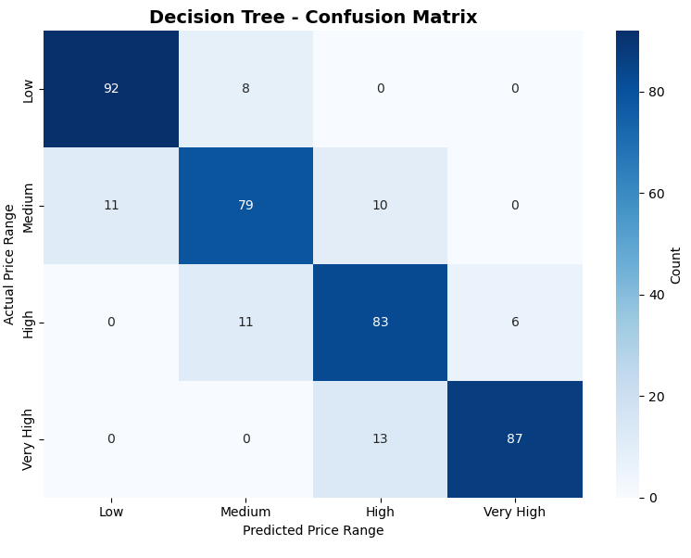
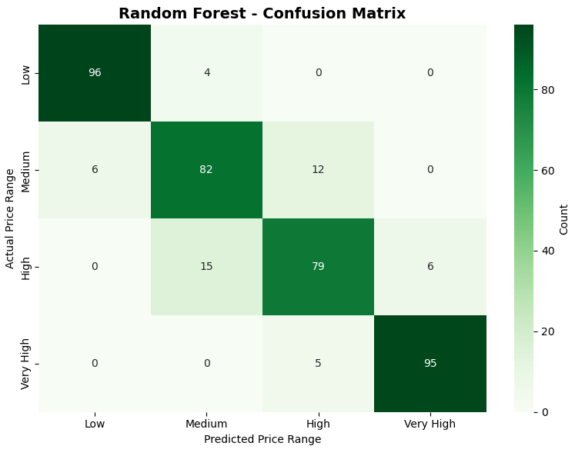
🔄 Mobile Price – Confusion Matrix

Slide 8

🐾 Animal Image Classifier

Slide 9

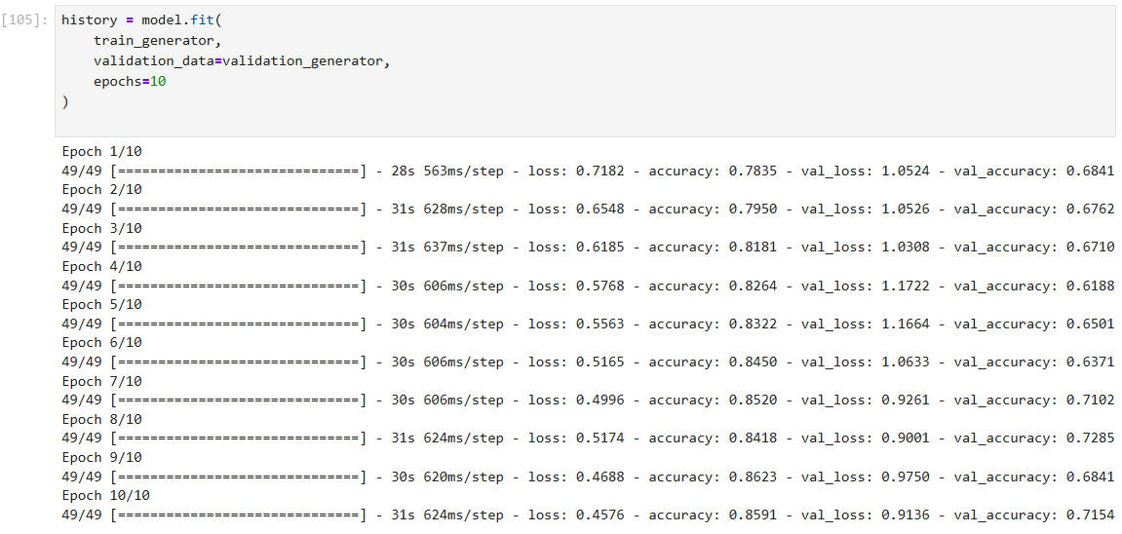
📈 Animal Classifier - Training History

Slide 10
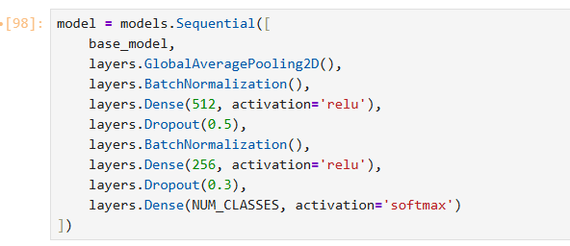
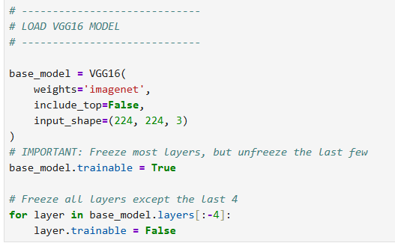
📈 Animal Classifier - Model
Transfer Learning
CNN Model

Slide 11
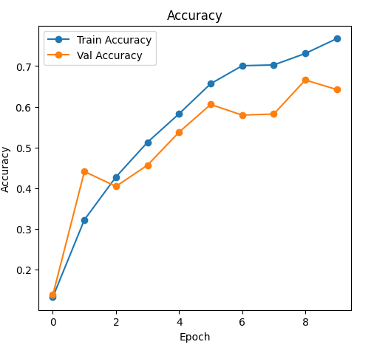
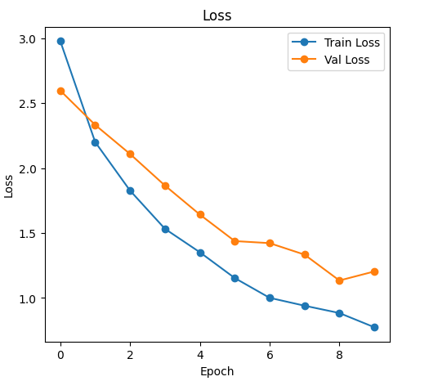
📈 Animal Classifier – Accuracy & Loss Graphs

Slide 12
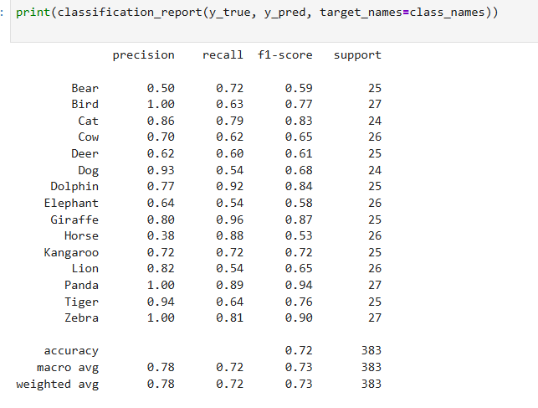
📈 Animal Classifier – Classification Report

Slide 13
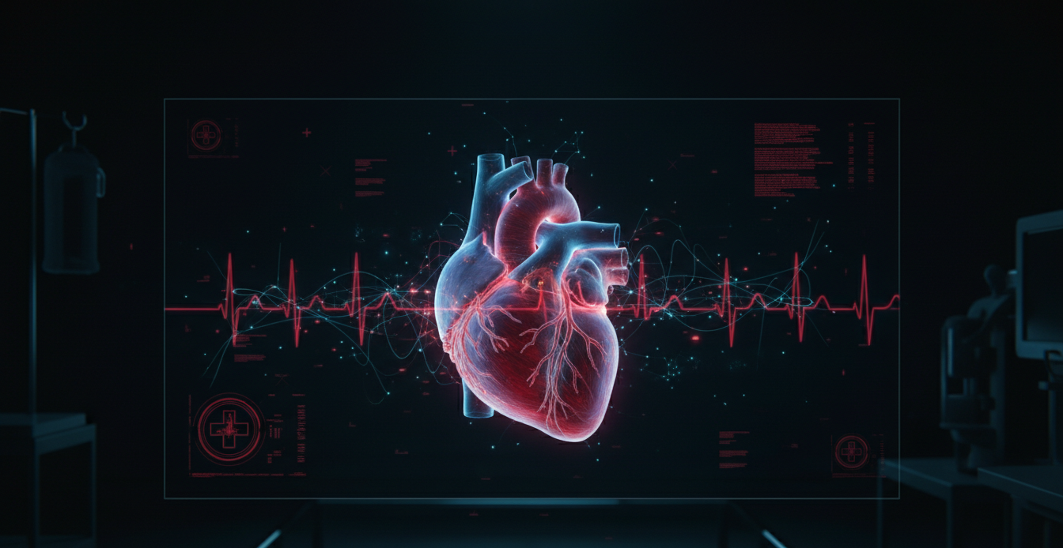
💓 Heart Disease

Slide 14
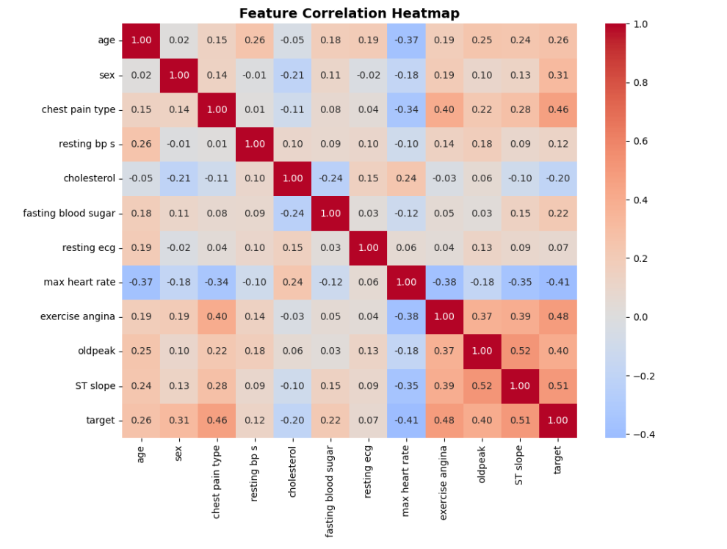
💓 Heart Disease – Correlation Heatmap & Predictions

Slide 15
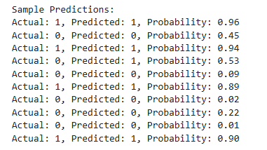
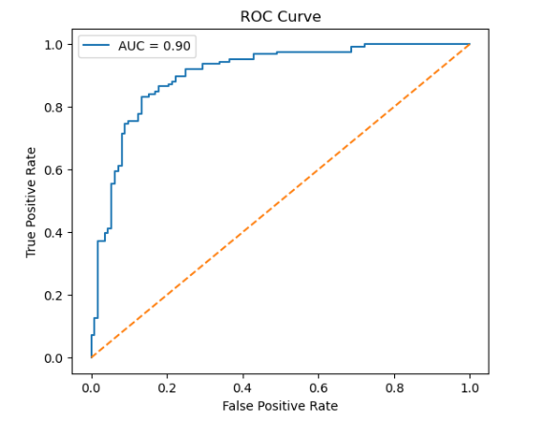
💓 Heart Disease – Correlation Heatmap & Predictions

Slide 16
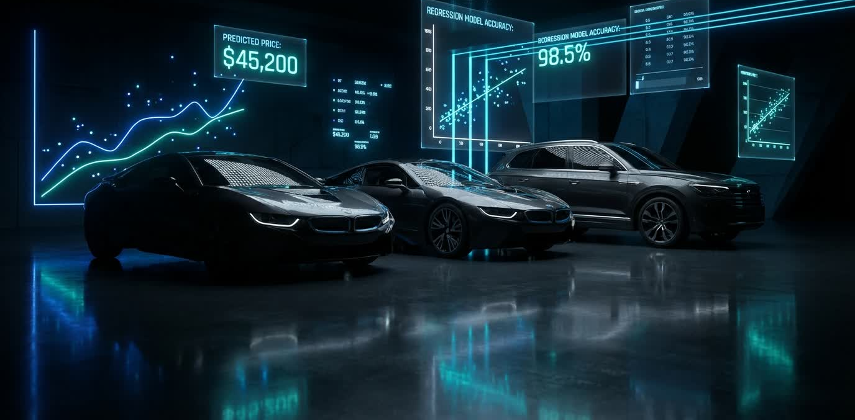
🚗 Vehicle Price Prediction

Slide 17
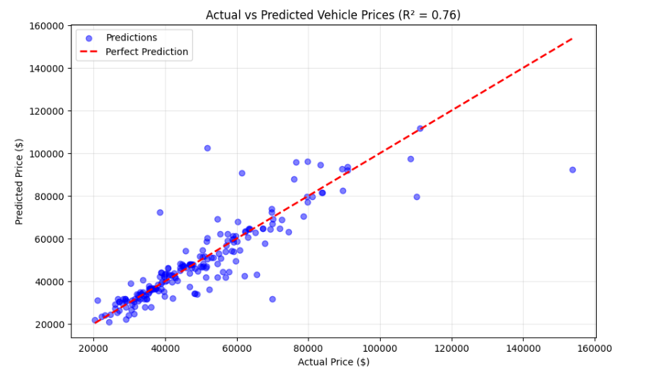
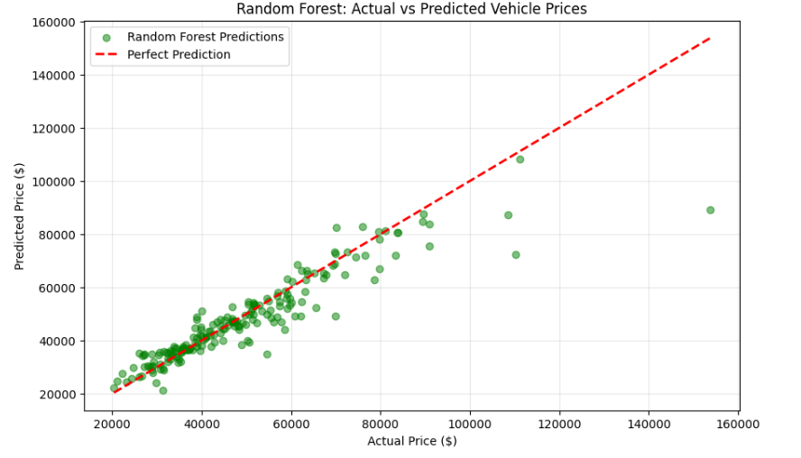
🚗 Vehicle Price - Best Fit Lines
Linear Regression
Random Forest classifier

Slide 18
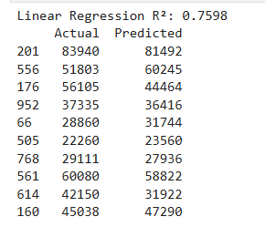
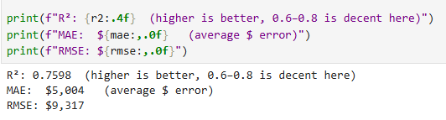
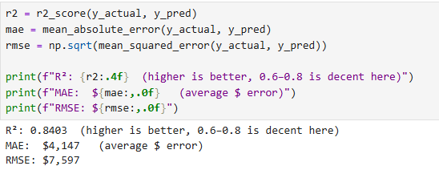
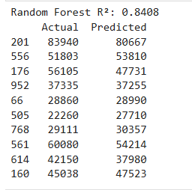
🚗 Vehicle Price - R² Score & Predictions
Predictions
Predictions

Slide 19
🛠️ TECH STACK
Python • TensorFlow • Keras • scikit-learn
Pandas • NumPy • Matplotlib • Seaborn
💬 Let's Connect!
#MachineLearning #AI #DataScience

